Slide 1
An Introduction to Database
Introduction to Database for Undergraduate Study
Lecture 9
JOIN Command
Joining 2/3 Tables
GROUP BY/HAVING Clause
This lecture and its associated materials have been produced by Mr. Rohit Panday (M.Sc. IT, 10+ Years of Industry/Academic Experience) of iAcademy for the purposes of lecturing on the above described subject and the material should be viewed in this context. The work does not constitute professional advice and no warranties are made regarding the information presented. The Author and iAcademy do not accept any liability for the consequences of any action taken as a result of the work or any recommendations made or inferred. Permission to use any of these materials must be first granted by iAcademy.

Slide 2
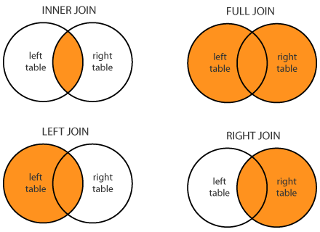
SQL JOIN
JOIN’s are used to retrieving the records from multiple tables.
SQL allows you to take JOIN’s on multiple tables from same database as well as different databases from same server.

Slide 3
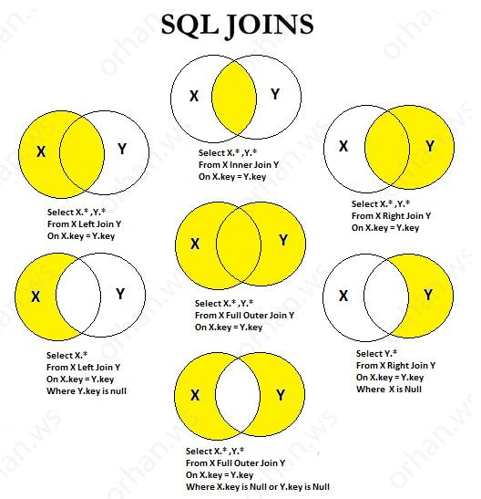
SQL JOINS
Visual Presentation of Types of JOINS

Slide 4
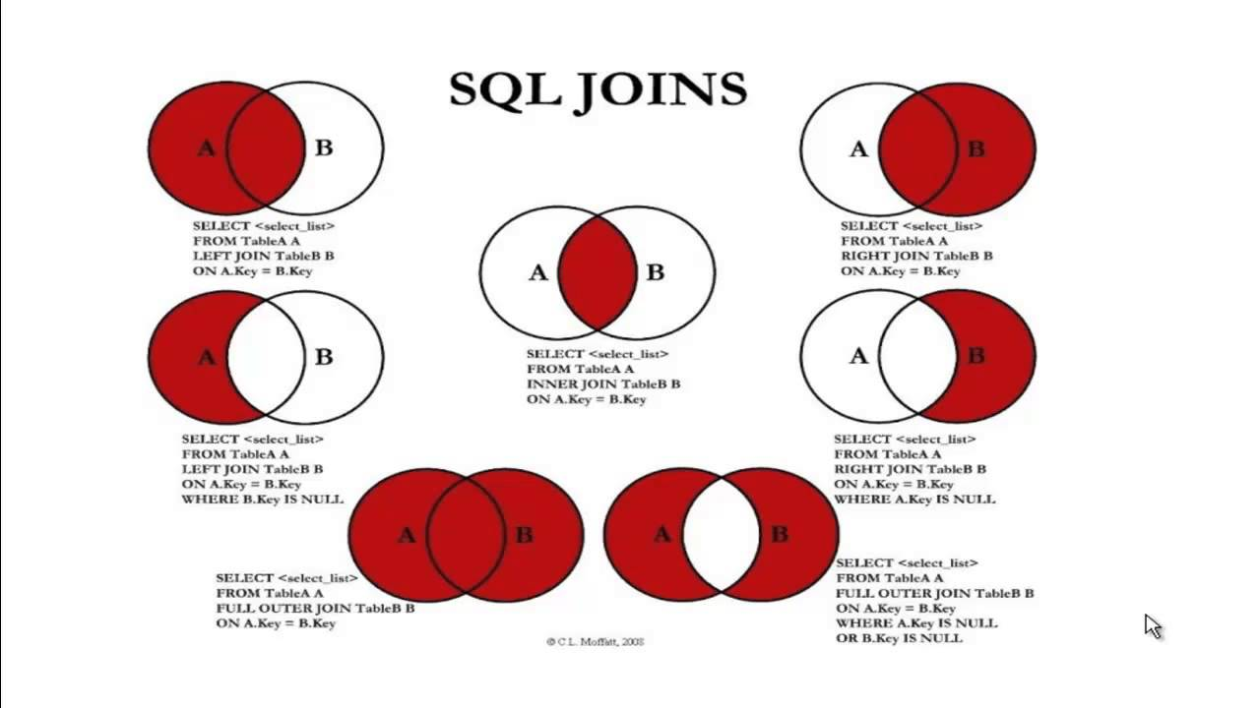
JOINS

Slide 5
Why should we JOIN tables ?
Data remain at Different Tables
Tables are JOINED through Primary and Foreign Keys
Full Data about an Entity remains only in a TABLE
Reports/Visual Layouts need to be more explanatory
Need to show all data from Various Tables

Slide 6
JOIN - Types
INNER
Selects all rows from both tables as long as there is a match between the columns of both tables (Table 1 and Table 2)
LEFT
Returns all rows from left table (Table 1) with the matching rows in the right table (Table 2)
RIGHT
Returns all rows from right table (Table 2) with the matching rows in the left table (Table 1)
FULL
Combines results when there is a match in any of tables (Table 1 and Table 2)

Slide 7
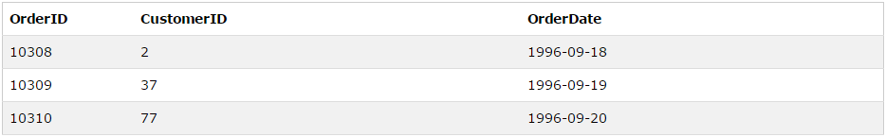
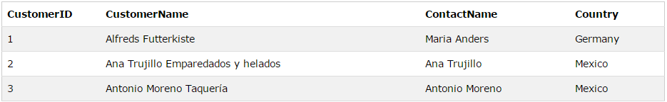
Example Tables
Order Table
Customer Table
How can I get Name of Customers with OrderID and OrderDate ?

Slide 8
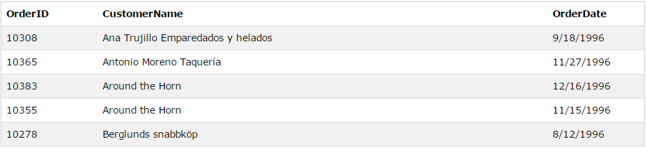
Inner Join
Example | SELECT Orders.OrderID, Customers.CustomerName, Orders.OrderDate FROM Orders INNER JOIN Customers ON Orders.CustomerID=Customers.CustomerID;
Meaning
The "CustomerID" column in the "Orders" table refers to the "CustomerID" in the "Customers" table. The relationship between the two tables above is the "CustomerID" column.

Slide 9
Inner Join - Syntax
Syntax | SELECT column_name(s) FROM table1 INNER JOIN table2 ON table1.column_name=table2.column_name;
Syntax | SELECT column_name(s) FROM table1 JOIN table2 ON table1.column_name=table2.column_name;

Slide 10
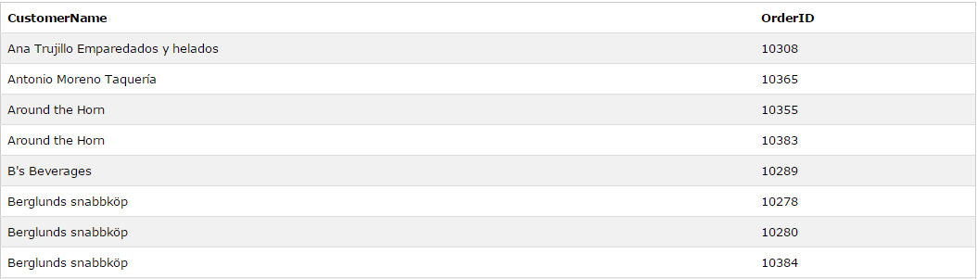
Inner Join - Demo
Example | SELECT Customers.CustomerName, Orders.OrderID FROM Customers INNER JOIN Orders ON Customers.CustomerID=Orders.CustomerID ORDER BY Customers.CustomerName;
Image

Slide 11
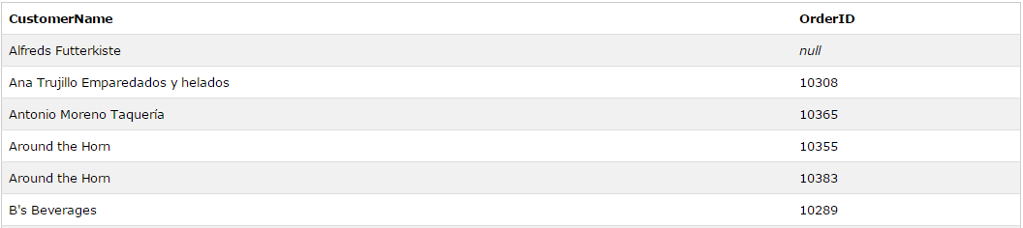
Left Join - Demo
Example | SELECT column_name(s) FROM table1 LEFT JOIN table2 ON table1.column_name=table2.column_name;

Slide 12
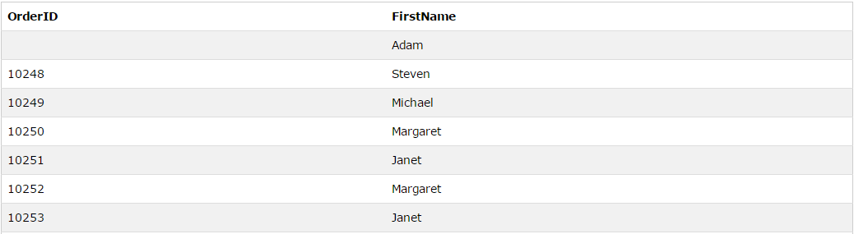
Right Join - Demo
Example | SELECT column_name(s) FROM table1 RIGHT JOIN table2 ON table1.column_name=table2.column_name;

Slide 13
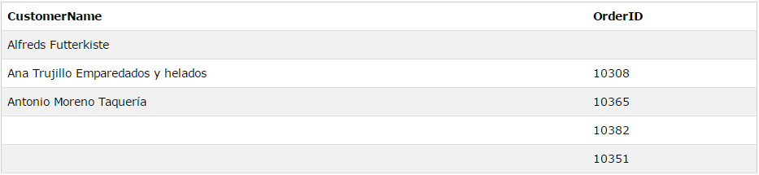
Full Join - Demo
Example | SELECT column_name(s) FROM table1 FULL OUTER JOIN table2 ON table1.column_name=table2.column_name;

Slide 14

Self Join - Demo
Example | SELECT G1.gid, G1.first_name, G1.last_name, G2.gid, G2.first_name, G2.last_name FROM Gardners G1 INNER JOIN Gardners G2 ON G1.first_name = G2.first_name

Slide 15
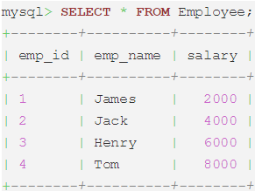
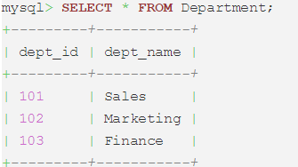
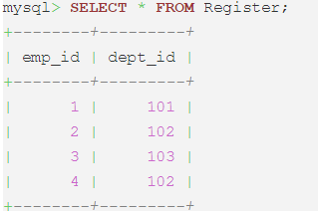
Joining Three Tables

Slide 16
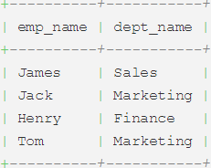
Joining Three Tables
SELECT emp_name, dept_name FROM Employee e JOIN Register r ON e.emp_id=r.emp_id JOIN Department d ON r.dept_id=d.dept_id;

Slide 17
GROUP BY Clause
Aggregate Function
Uses multiple rows as input and returns single row as output
Grouping
Used to group the columns with similar values

Slide 18
Group By Clause
Syntax | SELECT column_name, aggregate_function(column_name) FROM table_namecWHERE column_name operator valuecGROUP BY column_name;
Result | The GROUP BY statement is used in conjunction with the aggregate functions to group the result-set by one or more columns.

Slide 19
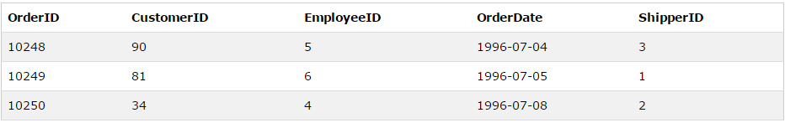
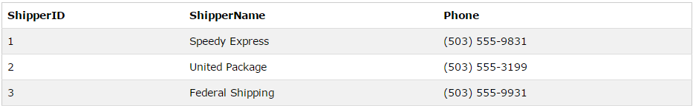
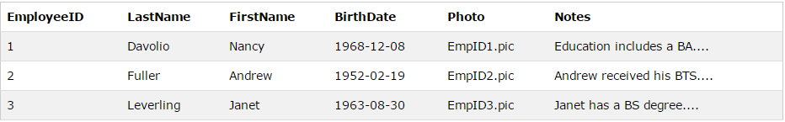
Group By Clause

Slide 20
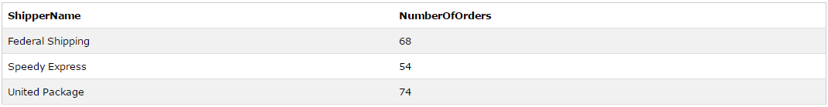
Group By Clause
Syntax | SELECT Shippers.ShipperName,COUNT(Orders.OrderID) AS NumberOfOrders FROM Orders LEFT JOIN Shippers ON Orders.ShipperID=Shippers.ShipperID GROUP BY ShipperName;
Result

Slide 21
HAVING Clause
Syntax | SELECT column_name, aggregate_function(column_name) FROM table_name WHERE column_name operator value GROUP BY column_name HAVING aggregate_function(column_name) operator value;
Result | The HAVING clause was added to SQL because the WHERE keyword could not be used with aggregate functions.

Slide 22
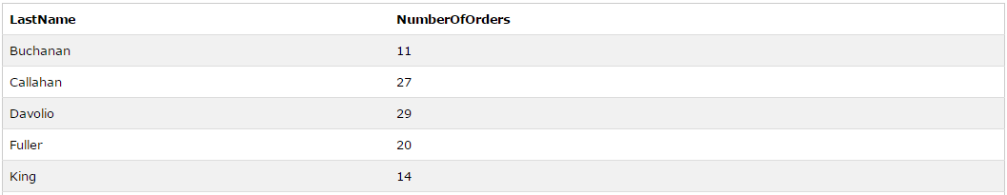
HAVING Clause
Syntax | SELECT Employees.LastName, COUNT(Orders.OrderID) AS NumberOfOrders FROM (Orders INNER JOIN Employees ON Orders.EmployeeID=Employees.EmployeeID) GROUP BY LastName HAVING COUNT(Orders.OrderID) > 10;
Result

Slide 23
Key Points

Slide 24

Laugh

Slide 25

End of Lecture for Week - 5

